Slide 1




NINU-Faculty of ENGINEERING
On The Ninu Supermarket System WebApplication

Slide 2


Meet the Team (Members)
Abdel-Rahman Gamal Hussein 
Mahmoud Ahmed Arafa
Abdullah Abdel-Raheem
Ali Khaled
Moaz Reda

Slide 3
Contents
Introduction
Project Methodology
Database Normalization
Schema Architecture
Entity Relationship Diagram (ERD)
Implementation & SQL
Bonus: The Implementation Layer (Web POS)

Slide 4

Introduction
Project Overview
A complete local web application for supermarket point-of-sale management.
Bridges the gap between theoretical ERD design and practical web interface.
Focuses on daily operations: products, sales, suppliers, and inventory.
Fully functional local environment (No cloud dependency required).
Visual Idea: Icon of a supermarket cart linked to a database icon.

Slide 5

Studio Shodwe
Project Methodology
Database Development Life Cycle
Requirement Analysis: Identifying 20+ retail entities and their business rules.
Conceptual Design: Creating the ERD with proper cardinality (1:N, M:N).
Logical Design: Mapping ERD to a Relational Schema.
Physical Implementation: Scripting the DB using SQL Server/SQLite with constraints.
www.reallygreatsite.com

Slide 6
Database Normalization
From Raw Data to 3rd Normal Form (3NF)
Eliminating Update, Insertion, and Deletion Anomalies.
Separating Admin, Catalog, and Transactional data for better maintenance.
Ensuring each attribute is functionally dependent only on the Primary Key.

Slide 7
Schema Architecture
01
Admin & Operations Module
03
Sales & Transactions Module
Centralized Governance: Manages the core hierarchy of the supermarket using branch and department entities.
Human Capital Management: Tracks employee data, role assignments, and security permissions.
Operational Accountability: Utilizes the shift table to record opening_balance and closing_balance, ensuring financial integrity at each register.
Transactional Integrity: Separates sale headers (sale) from line items (sale_item) to achieve 3rd Normal Form (3NF).
Financial Precision: Uses DECIMAL(18,2) for all monetary fields to prevent rounding errors in total_amount and tax_amount.
Payment Flexibility: Supports multiple pay_method types (Cash, Visa, Points) via the payment entity.
02
Catalog & Supply Chain Module
04
Inventory Hierarchy: Organizes items through a multi-level category system for easier navigation.
Stock Control Logic: The product table includes a reorder_level attribute to trigger automated supply alertsa
Supplier Integration: Maintains detailed supplier profiles linked to purchase_order records for seamless procurement.
Customer Loyalty & Points Module
Customer Relationship Management: Tracks customer profiles and their interaction history.
Dynamic Loyalty Logic: The loyalty_account table calculates points_balance in real-time based on purchase value.
Membership Tiering: Implements automated logic for membership_level (Silver, Gold, Platinum) to drive customer retention.

Slide 8
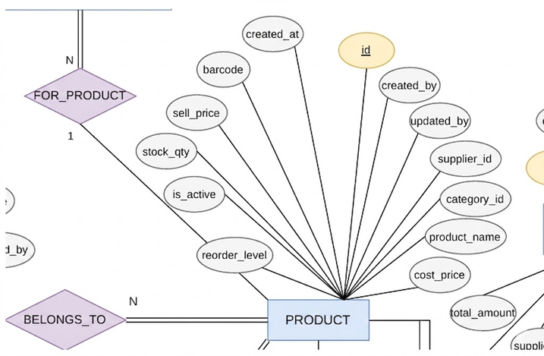
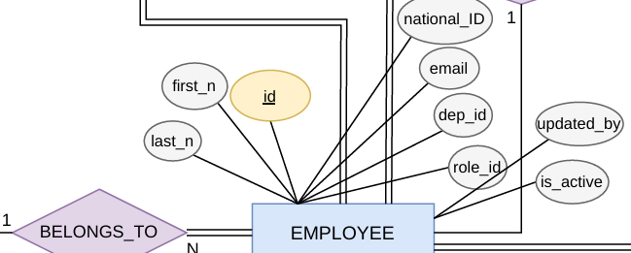
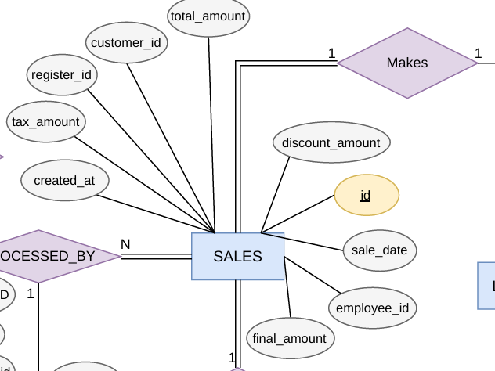
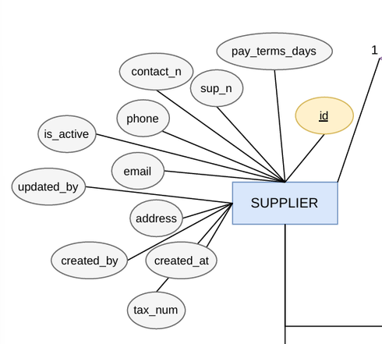
Entity Relationship Diagram (ERD)
Conceptual Design
Points:
20+ Entities (Employees, Products, Sales, Suppliers...).
Complex Cardinality (1:N for Sales, M:N for Discounts).
Participation Constraints (Mandatory/Optional).

Slide 9
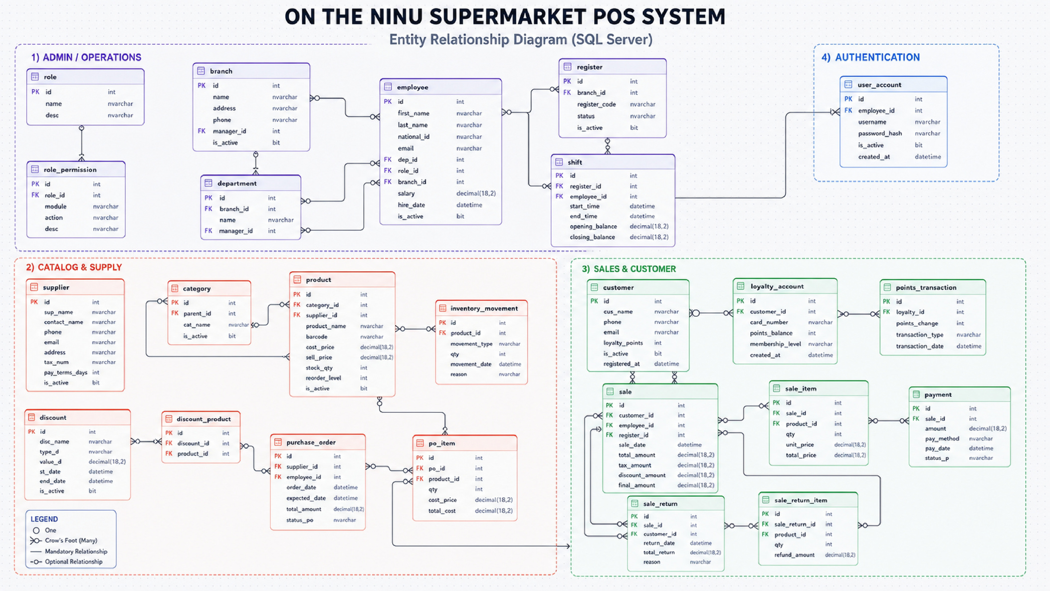
Full Entity Relationship Diagram (ERD)

Slide 10
Implementation & SQL
Physical Implementation
(SQL Server)
Advanced SQL Queries (The Power of JOINs)
Engine: SQL Server Relational Engine.
Multilingual Support: Utilizing NVARCHAR for all string fields (Names, Addresses) to support Arabic and English data without encoding issues.
Financial Precision: Using DECIMAL(18,2) for total_amount and unit_price to ensure 100% accuracy in calculations, avoiding the rounding errors of 'Float' types.
Temporal Accuracy: Using DATETIME2(0) for sale_date and shift logs to achieve precise auditing of every transaction
Multi-Table Joins: Linking sale ➔ sale_item ➔ product ➔ category to generate detailed performance reports.
Aggregation & Logic: Using GROUP BY and HAVING to isolate products where current_qty < reorder_level for automated inventory alerts.
Subqueries & CTEs: Calculating "Branch Performance" by comparing individual sale totals against branch-wide averages.
Complex Filtering: Using WHERE clauses for dynamic date-range reporting (Daily/Monthly revenue).
Data Integrity & Constraints
Transactional Security & Performance (Add-on)
Referential Integrity: Implementation of FOREIGN KEY constraints with ON DELETE NO ACTION to prevent accidental loss of historical sales data.
Domain Integrity (CHECK): SQL-level validation to ensure business rules (e.g., sale_item.qty > 0 and product.sell_price > cost_price).
Entity Integrity (UNIQUE): Enforcing business uniqueness for barcode, national_id, and card_number to prevent duplicate identities.
Default Values: Using GETDATE() and is_active = 1 for automated status management.
ACID Properties: Ensuring all sales transactions either complete fully or roll back (Atomic operations), especially when updating loyalty_points and inventory_movement simultaneously.
Indexing Strategy: Creating INDEXES on high-traffic columns like barcode and sale_date to reduce query response time from seconds to milliseconds.
Data Seeding: Custom SQL scripts to populate the system with realistic data for stress testing and demonstration.

Slide 11
Bonus: The Implementation Layer (Web POS)
The Implementation Layer (Web POS)
Conclusion & Future Work
Reports & Analytics
Generating "End of Shift" reports.
Tracking Inventory movements (inventory_movement).
Visualizing sales trends via chart integration.
Scalable design ready for SQL Server production.
Future: Adding Triggers for automated stock updates and Stored Procedures for complex reporting.
Developing a Web POS using FastAPI as a "Front-end" for the database.
Real-time CRUD operations directly affecting the tables.
Interactive Dashboard fueled by SQL Aggregation functions.

Slide 12
Thank you
for your attention

